Slide 1

CUI Abbottabad
Department of Computer Science
Object Oriented Programming
Lecture No. 9
Encapsulation

Slide 2
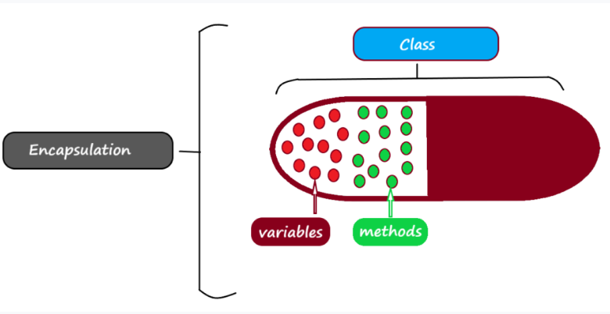
Encapsulation
The idea behind encapsulation is to hide the implementation details from users. If a data member is private it means it can only be accessed within the same class. No outside class can access private data member (variable) of other class.

Slide 3
Advantages of Encapsulation
We can make read-only and write-only classes using encapsulation.
We can achieve data hiding.
The encapsulated classes are better for unit testing.
Avoid unauthorized access
We have control over data.
Keep code and data safe from out side

Slide 4
Example 1: Encapsulation
class Test {
public int a, b; // public access
private int c; // private access
// methods to access c
void setc(int i) { // set c's value
c = i;
}
int getc() { // get c's value
return c;
}}
//main . . .
Test ob = new Test();
ob.a = 10; //ok
ob.b = 20; //ok
// ob.c = 100; // Error!
// You must access c through its methods
ob.setc(100); //ok
System.out.println(ob.a+ ”\t” + ob.b + “\t” +ob.getc());

Slide 5
Example 2: Read only (Getter method)
class A{
private int x = 99;
int getter(){
return x;
}
}
//main. . .
//The value of x can’t be changed.
A ob = new A();
System.out.println(ob.getter());
Note: Mostly it used to generate reports

Slide 6
Example 3: Write only (Setter method)
class A{
private int x ;
void setter(int j){
x = j;
}
}
//main. . .
//The value of x can’t be changed.
A ob = new A();
//ob.x = 99; //Error
ob.setter(99);
//only class members may change/access private attributes, not from the outside

Slide 7
Example 4: Demonstrate both getter & setter methods
class A{
private int emp_id;
private String name;
void set_id(int j){
emp_id = j;
}
void set_name(String n){
name = n;
}
int get_id(){
return emp_id;
}
String get_name(){
return name;
}

Slide 8
//main . . .
A ob = new A();
ob.set_id(100);
ob.set_name(“Muhammad Umar”);
System.out.println(ob.get_id());
System.out.println(ob.get_name());

